Slide 1
Lab. 13
Logic Design Lab.
Spring 2014
Prof. Naehyuck Chang
(naehyuck@snu.ac.kr)
TA. Taeyoung Kim
(tykim@iris.snu.ac.kr)
TA. Duseok Kang
(kangds0829@iris.snu.ac.kr)

Slide 2
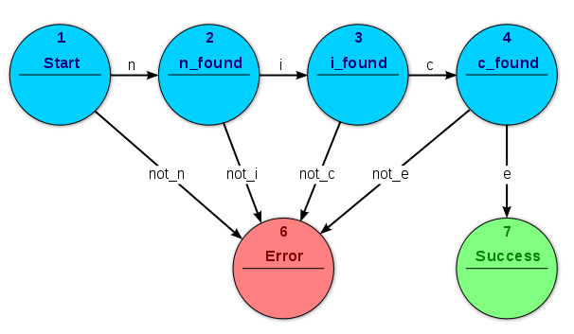
FSM
Acceptor FSM: parsing the word "nice"
A model of behavior composed of a finite number of states, transitions between those states, and actions.
An abstract model of a machine with a primitive (sometimes read-only) internal memory.

Slide 3
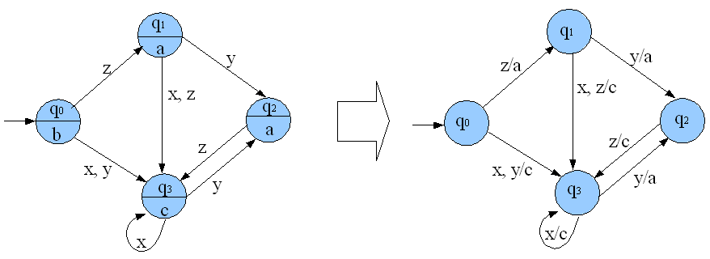
FSM: Moore & Mealy Machine
Moore & Mealy machine
Moore Machine: The FSM uses only entry actions, i.e., output depends only on the state.
Mealy Machine: The FSM uses only input actions, i.e., output depends on input and state.

Slide 4
FSM: Moore & Mealy Machine
0
0/a
q0
a
q1
b
q0
q1
1
1/b
Moore & Mealy machine

Slide 5
Practice
String Recognizer
Simulate the string recognizer which accepts specific bit strings.
There are 1-bit input and 1-bit output in this string recognizer.
This string recognizer accepts ‘010’. If strings are inputted except ‘010’, the output must be ‘0’.
If ‘100’ is inputted, the output must be ‘0’ permanently.
You can use ‘D-FF’ to represent states in FSM.
Input ‘00101010010’ to verify your circuit at your simulating step.
Implement
Draw the FSM for string recognizer using any drawing tool.
Simulate the FSM with Xilinx ISE.
Implement the FSM on breadboard.

Slide 6
Preliminary Report (14th)
Requirements
Either in Korean or in English
No cover page
At least 1 page
Write your group, student number, name
Due : May, 19th
Study ‘Chatterless switch’
Explain about ‘Chattering’ and implementation of ‘Chatterless
switch’ using registers and capacitor.

